Slide 1
Assessment and Emergent Bilingual Students
By Elise Heiting
Designed for Pre-Service Elementary Education Students

Slide 2
Why is it important that we learn about Assessments for Culturally and Linguistically Diverse students?

Slide 3
Why is this important?
As future elementary education teachers in America, we will ALL teach culturally and linguistically diverse students at some point in our career.
One in five students in the US is the child of an immigrant, and most of these students speak a language other than English at home (Gandara and Hopkins, 2010)
Even though all of use will be teaching students learning English, we are not required to have explicit training in the subject.

Slide 4
Why is this important?
How does this relate to assessment?
Important and unique considerations need to be made regarding the assessment of emergent bilingual students.
There could be serious consequences if teachers and schools are not aware of these unique considerations and do not make informed assessment accommodations for their emergent bilingual students.

Slide 5
U.S. Laws/Illinois Laws
19 or more law
What happens to the rest of the students who are not placed in a bilingual class??
Notes:
The law regarding English Language Learners in Illinois states that if there are 19 or more students from the same language background in the same school, the school must provide a transitional bilingual education program for the students. In this case, certified bilingual education teachers will teach the students with support in the native language. However, when there are less than 19 students from the same language background, the students are placed in a transitional program of instruction, which provides students with daily English as a Second Language lessons (usually pullout) and provides support in the native language to the extent practical. That means that these students will be placed in general education classrooms for most of the day, so it is up to general education teachers like you to know the unique learning needs of your culturally and linguistically diverse students.

Slide 6
Some Important Terminology
ESL: English as a Second Language
ELL: English Language Learner
CLD: Culturally and Linguistically Diverse
L1/L2: First Language, Second Language
NL: Native Language
TWI: Two Way Immersion
LEP: Limited English Proficient
TBE- Transitional Bilingual Education
TPI- Transitional Program of Instruction
SLA- Second Language Acquisition
HLS- Home Language Survey
Notes:
Acronyms are used all of the time when discussing bilingual students and the education of bilingual students. Before we begin really discussing assessments and bilingual students, let’s go over some of these acronyms to make sure you know them for the rest of the presentation and for when you education bilingual students in the future.

Slide 7
What’s most respectful?
Culturally and Linguistically Diverse Students
Emergent Bilingual
Why is this even important?
Notes:
As you can see, there are many different terms used to describe students that are learning English in American schools. So which one do we use? Two of the best terms to use to describe these students is ‘culturally and linguistically diverse’ or even better, ‘emergent bilingual’. (García, Kleifgen, and Farchi (2008) from DiNicolo, 1/19/12, Slide 3)
These terms play a large role in not only how are students feel most valued in the class, but also in shaping our own conceptions of our student’s cultural and linguistic knowledge and backgrounds and how that affects their learning and assessment. If we use terms such as emergent bilingual, we are recognizing that they came to school with a valid language that must be recognized and built off of while the students begin to learn content and English.

Slide 8
Attitudes/Myths/Identities and YOU
Understanding Myths about bilingualism, immigration, and diverse cultures in America
Shaping your attitudes through personal reflection, open mindedness, and sound research
Understanding what shapes your own identities, what shapes your students’ identities, and how they affect teaching and learning in the class

Slide 9
Unique Aspects and Considerations for Emergent Bilinguals

Slide 10
Role of Assessment
Large Scale Assessments
Identification and placement
Reclassification
Information to teachers, schools, states, county
Classroom
Monitors progress of students
Gives teacher opportunity to understand students’ knowledge
Feedback to students
Notes:
X
This presentation will discuss two different types of assessments in schools in America: Large Scale Testing and Classroom, or formative assessments. Both large scale assessments and classroom assessments play active roles in student learning, teacher instruction, and the way American schools today function. Large scale assessments, or standardized assessments, are used for many different reasons. Standardized content assessments such as the ISAT measure student learning and growth in content, while standardized tests such as the ACCESS test measure English language proficiency. Such tests used in Illinois aid in the identification of English Language Learning students, the placement of the students after they are identified, and whether or not they can exit the program. Such tests also give information to the students, teachers, schools, states, and country as a whole regarding the achievement of students. Emergent bilingual students are placed in their own subgroup for achievement on such large scale assessments, so their achievement is closely watched. These tests, however, do not provide immediate feedback to students so that they can improve their learning or so that teachers can improve their instruction (McKay 2006).
We will also discuss the use of classroom assessments, which give much more immediate feedback. Classroom assessments are used to monitor students progress and growth, to give teachers the opportunity to understand students’ knowledge, and to give feedback to both the students and the teacher regarding learning and instruction. Classroom assessments are a crucial aspect to learning in the classroom, and it is essential that teachers create their classroom assessments and instructions with the needs and considerations of emergent bilingual students in mind.

Slide 11
Assessments Unique to Emergent Bilinguals
Purposes | Assessments
Identification and placement | HLS, questionnaires, English language proficiency test
State accountability of academic progress and English language proficiency | State English language proficiency exam State assessment for academic achievement High school exit exams District assessments in L1 and L2
Content learning English language learning | Formative/Classroom assessments District assessments in L1 and L2
Reclassification | Teacher recommendation English language proficiency assessment
Program and placement | Additional services/programs – RTI Parent input Classroom assessments
Chart From DeNicolo, 1/19/12, Slide 12
Notes:
This chart shows the aspects of education unique to emergent bilingual students in which assessments are needed. These aspects of schooling are not a factor for students’ who’s native language is English, because all of these “purposes” deal directly with the student’s level of English language proficiency or their status as a non-native English speaker. As you can see, standardized tests serve many different purposes for emergent bilingual students, so it is even more important that the assessments are reliable and measure authentic knowledge of the students in a linguistically and culturally accessible manner. We will be looking at a few of the different purposes in which some of these assessments are used.

Slide 12
Identification and Initial Placements in Illinois
NCLB requires identification of students as “ELL”, but with no guidance provided on how to do so
Home Language Survey-Illinois
English Language Proficiency Test (ACCESS)
Use score and program availability to place students
Notes:
One of the first assessments that emergent bilingual students encounter in schools are the assessments used for Identification and Initial Placement. The assessment is actually a survey called the Home Language Survey. NCLB requires that all states provide some way to identify if students are English Language Learners, but there are no guidelines given as to how states are to do so, (Durán 2008). In response, each state has developed their own version of a Home Language Survey- a questionnaire that is used to identify if students are non-native English speakers.
State surveys differ between the number of questions asked and the questions that are asked, but the basic purpose of the survey is used for identification of students in need of linguistic support. In Illinois, the schools that you will work in will administer a Home Language survey to each new coming student which contains two questions: (1) Is there a language other than English spoken in the home? (2) If so, what is it? If the student is identified as having a language other than English spoke in the home, they must take an English language proficiency assessment within the first 30 days of enrollment, (DeNicolo, 1/29/2012, Slide 16).
However, do you think that the two questions asked on the HLS give sufficient information as to the students linguistic background? What would you want to know to make informed decisions about placement and instruction as a teacher? Other states have more in depth HLS’s that ask for the students L1 proficiency in reading, writing, listening, and speaking, as well as their proficiency in reading, writing, listening and speaking in English. Some ask what the student is used to speaking and listening to, an to which extent students are exposed to English in the home. All of these factors play a large role in the students learning of content and English in school, so I believe it to be important to gather more information through a home language survey in order to provide the most appropriate and effective placement for emergent bilingual students.
Once students take their English Language Proficiency Test, (in Illinois – The Access Test) their score along with program availability determines the student’s program placement. ESL teachers often group their student blocks by proficiency levels and bilingual teachers will shelter their instruction an make assessment accommodations regarding the levels of English language proficiency in classrooms.

Slide 13
Over Identification and Placement
Emergent bilingual students are often seen as having developmental delay or learning disabilities because of misunderstandings regarding LINGUISTIC BARRIERS
“Unless educators have substantial knowledge of, and are responsive to, the unique sociolinguistic needs of CLD students, these students are at greater risk for being misidentified, mislabeled, and consequently miseducated in our schools,” (Herrera, Murry, Cabral, 2007, p. 216).

Slide 14
Over Identification/Disproportionality and Placement
Disproportionality Chart (Herrera, Murry, Cabral, 2007, p. 219)
 | American Indian | Asian | African American | Caucasian | Hispanic | Biracial/Other
School District Population | 5% | 10% | 20% | 35% | 25% | 5%
Gifted/Talented |  | 16% | 4% | 75% | 4% | 1%
Learning Disabilities |  | 4% | 27% | 36% | 33%
Speech/Language Impaired | 3% | 14% | 19% | 30% | 33% | 1%
Behavior Disorder |  |  | 34% | 28% | 31% | 7%
Visually Impaired | 6% | 8% | 22% | 37% | 24% | 3%
Notes:
Look at this chart. The red numbers represent percentage of a school district’s population. Looking at those percentages, what stands out to you on this chart?

Slide 15
Over Identification and Placement-
Disproportionality Factors (Herrera, Murry, Cabral, 2007, p. 220-222)
Racial and ethnic minorities more likely to be in poverty
Factor in SPED referrals and placements
Typically have less opportunities to quality education and highly teachers
Make decisions based on insufficient information
Misinterpret culturally different behaviors
Examples??
Learning a second language often causes academic, attention, and behavior difficulties
Notes:
Herrera, Murry and Cabral (2007) describe factors that play into disproportionality and over-identification of disabilities in regards to linguistically and culturally diverse students. One factor that the authors describe is poverty and its connection to over-identification of disabilities in the classroom. First off, racial and ethnic minorities, who are often non-native English speakers, are more likely to live in poverty, thus having typically less opportunities to quality education and highly qualified teachers. Quality education and highly qualified teachers correlates with awareness regarding second language acquisition and language learning and it’s role in the classroom, and without this awareness, teachers may misinterpret limited English use for a language or development delay or a learning disability.
Another factor that plays a role in the overidentification of disabilities about CLD students is that schools and teachers often make decisions regarding instruction, assessment, and placement based on insufficient information and research. It is essential that teachers and schools stay up to date and use strong and reliable research as a foundation for instruction, assessment, and placement of students.
Another factor that I believe to play a large role in overidentification is that teachers misinterpret culturally different behaviors that they believe indicate a disability of some sort. For example, some cultures believe it is disrespectful at someone of authority in the eyes, where as in America, eye contact is seen as a sign of respect and attention. Teachers may misinterpret a student’s lack of eye contact and tracking throughout a lesson to mean that the students are not comprehending what the teacher is saying or that they are unable to pay attention. In reality, the student is just as likely to be paying attention and comprehending the instruction as the native English speaking student tracking the teacher and making eye contact. Can you think of some examples of how cultural differences can be misinterpreted as a learning/language/behavioral disability or delay?
The last factor Herrera, Murry, and Cabral (2007) describes is that learning a second language often causes academic, attention, and behavior difficulties. Teachers that are not aware of the affects on learning a second language on all aspects of a students’ life may misunderstand difficulties as deficiencies. However, the more educated a teacher is regarding the process of language learning and how it affects all areas of a students’ life, the more informed their decisions will be regarding these difficulties and how to react to them.

Slide 16
Reclassification
Students eventually exit their ESL or bilingual programs by passing a test
In Champaign/Urbana, test used is the ACCESS
Students must meet a 4.8 composite score out of 6 and a score of 4.2 out of 6 in literacy to exit the program
Monitored for 2 years after exiting program
Notes:
Another unique aspect of assessment to emergent bilingual students are the assessments that determine if students can exit their ESL or bilingual education programs. The assessments are used to assess student progress in achieving English language proficiency that is required under NCLB. NCLB requires that ELL students are assessed annually for English proficiency growth and academic progress.
In Champaign Urbana, the test used is the ACCESS test is used to determine the level of English language proficiency. ACCESS stands for Assessing Comprehension and Communication in English State to State. It is used to measure both social and academic proficiency in English.
Students are scored on their overall composite score (math, social studies, science, social language) and their literacy in English on a scale from 0-6. In order for students to exit their ESL or bilingual programs and transfer into an all English setting, they must achieve a 4.8 score or higher on the composite and a 4.2 or higher of English language literacy. Once the student exits, their progress is still monitored for the next two years to make sure they are succeeding in the all English setting.
We could spend all day talking about if this test is useful and a fair assessment, but we don’t have time right now. We’ll talk later on about what makes a test useful and fair.

Slide 17
Important Considerations and Knowledge Needed for Teaching and Creating Assessments for Emergent Bilinguals

Slide 18
Aspects of Language Learning
Vulnerability
Growth
Three Main Considerations (McKay 2006)
Literacy
Notes:
McKay (2006) describes the three main aspects that play the most influential role in language learning in regards to young language learners that teachers must focus on during classroom instruction and assessment: Growth, Literacy, and Vulnerability. Teachers need to be very aware of how each of these tenants of language learning individually is affecting their students, and how to build upon their growth, literacy, and vulnerability to aid in the development of content and English language development in the classroom.

Slide 19
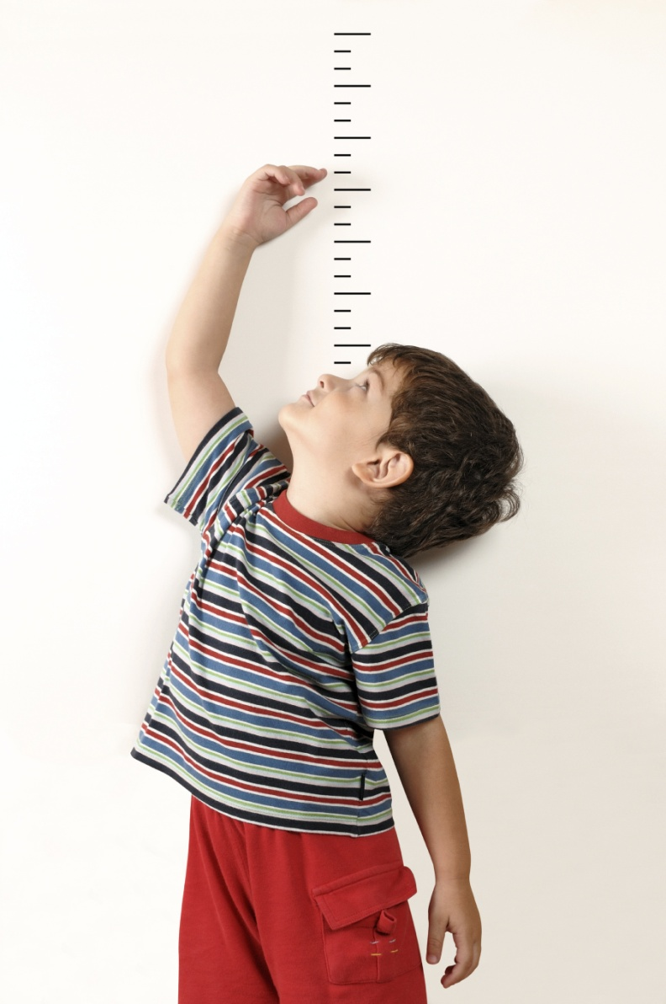
Growth
Cognitive
Metalinguistic awareness
Impact of young bilingualism
Learn through direct experiences
Assessments age appropriate
Social/Emotional
Social skills
Introvert/extrovert
‘psychologically safe’
enviornment
Physical
Notes:
One of the greatest pleasures of teaching elementary school children is to be able to witness their tremendous growth in all facets of their life. It is imperative that elementary school teachers understand child development and how a child’s growth and development play a pivotal role in learning. This is the same for students that are learning language. Teachers must be aware of how children at their specific age grow in different ways, and what that growth implies for teaching culturally and linguistically diverse students.
It is important for teachers to understand implications of cognitive growth for the age that they are teaching in order to make instruction informative and accessible. Language learners in the classroom are not only learning content, but they are also learning another language and trying to make meaning with the new information and language they are being exposed to. After the age of 8 or so, students are are developing metalinguistic awareness, or using language to talk about, be conscious of, and make decisions regarding language use. Cognitively, they’re minds are working very hard and soaking up knowledge and making connections to previous knowledge tremendously. Research has also show that cognitive in young bilinugals has a positive and influential impact of their learning and perceptions of the world(McKay 2006), so creating assessments that foster the maintenance or develop of the L1 will benefit these students and their cognitive growth. It is important that teachers of emergent bilinguals and all students teach through direct experiences so that students can make connections to gain understanding with the help of visual aids and objects, (McKay 2006).
Students are growing socially every day in school. Culturally and linguistically diverse students may have trouble understanding or developing social skills, because their social skills and norms may have been different in their home culture. Teachers can help by teaching about different social skills and how to develop them together as a class. Students need to feel that they are valued and safe in the classroom, which McKay describes as a ‘psychologically safe’ environment. Promoting respect among all students and strictly enforcing respectful and positive social interactions in the class will allow for this safe environment.
In order to construct the most appropriate assessments and task, a student’s physical growth and abilities at the age level must also be considered. You would not give a kindergarten student an assessment that graded them on their ability to use fine motor skills, because those skills still need to physically develop.
To tie it all together, McKay (2006) writes “Teachers and assessors therefore need deep knowledge of children’s development– their cogntivie, social and emotional and physical growth– in order to be able to select and construct he most appropriate assessment tasks and to give appropriate feedback,” (McKay, 2006, p. 11).

Slide 20
Vulnerability
Heightened sensitivity to praise, criticism, and approval
Self esteem strongly influenced by experiences at school
Need experiences that make them feel successful and good about themselves
Need for flexibility in assessment to ensure success for all students
McKay 2006 p. 14-15
Notes:
Young language learners are extremely vulnerable in their early years in school. Very close attention and awareness needs to be used while instruction, interacting, and assessing these young learners. Developing a new language along with just being a young child in school heightens sensitivity to praise, criticism, and approval, (McKay, 2006, p. 14). Therefore, teachers should make sure to give an abundance of praise, very positive, direct, and constructive criticism, and make the student feel valued and safe in the classroom. If a student receives a test back measuring English language proficiency with red marks all over it and 0%, when their English language skills are still developing, the student will most definitely shut down and their confidence will be ruined. As McKay describes, self-esteem is strongly influenced by experiences at school, so it is essential for teachers to provide as many opportunities as possible that make students feel successful and good about themselves. In order to do this, teachers need to be flexible in creating and reviewing assessments to ensure that the assessments give ample opportunities for students to be successful.

Slide 21
Literacy
Learning literacy skills at the same time as they are learning the target language
Development of understand of how reading and writing works- foundation of literacy
Writing accompanied by drawings
Oral Language Development
CLD students skills in literacy in L2 build upon L1 literacy understanding and skills
What if there is no L1 literacy?
Notes:
It is pivotal that teachers understand that literacy development for young native English speakers and for emergent bilingual students is very different, and without careful planning and awareness, CLD students will not develop the literacy skills they need to be successful in school. McKay describes that the foundation of literacy is the understanding of how reading and writing works. Native English speakers will have this understanding because they have been exposed to books in their native language before school. However, CLD students do not have this same foundation, so it is essential that teachers build this foundation for English literacy skills with their students, and encourage the development of literacy in the first language. A concern regarding literacy for young CLD students is that many of the students at the start of school haven’t developed literacy skills in the first language, so they are not only trying to acquire a second language but also to learn literacy in the second language at the same rate as native English speakers, (McKay 2006). What are some teaching implications you can take away from this thought? (develop literacy in L1, allow for use of L1)
McKay writes that “oral language underpins literacy development for children learning literacy skills in their first language,” (McKay, 2006, p. 13). Teachers can use this knowledge to foster the development of oral language skills in the L2, and if possible, in the L1.
Overall, teachers need to be aware of how a students’ first language literacy will influence literacy in the second language, either positively or negatively, and make accommodations accordingly in instruction and assessment.

Slide 22
Considerations for Emergent Bilinguals- Second Language Acquisition
Cultural Codes (McKay
2006)
Silent period
Affective filter
Notes:
There are many considerations and characteristics regarding cultural difference and second language acquisition that will definitely affect a students demonstration of their knowledge. Many of these considerations and characteristics inhibit teachers from receiving an accurate understanding of their students’ knowledge and skills.
One of the major considerations that teachers need to be aware of in order to work on making their assessments more accessible to all students is to be aware of cultural codes. As described when discussing factors for disproportionality and misidentification, different views of eye contact in different cultures would be an example of a cultural code a student has grown up with. What are some other cultural codes that you can think of that teachers need to be aware of in order to give the most fair and useful instruction and assessments?
Another consideration that needs to be taken into account for emergent bilinguals is that the students may go through a silent period. Silent periods are a very normal stage in Second Language acquisition, and are characterized by students not attempted to speak in the second language, and sometimes even the first. Without a teacher that is aware of silent periods, they may misunderstand the child’s silence for lack of knowledge, skills, and language. This misunderstanding could have extremely detrimental affects on the students overall learning and education, and could result in misidentification of a learning disability or language delay. How would you access the knowledge from a student that is in a silent period?
Similar to the silent period, CLD students often develop an affective filter. As concisely stated by Herrera, Murry, and Cabral (2007), “The affective filter has been compared to a defense mechanism that controls the extent to which an individual internalizes input by converting it into learning,” (p. 54). In other words, the affective filter is when students filter what they say in the second language because of negative emotional variables such as stress, anxiety, self consciousness. This affective filter has extremely significant and negative affects of students ability to benefit from classroom instruction and assessment, (Krashen 1982, 2000), because these negative and stressful emotions get in the way of actual learning. Ways to reduce a students affective filter are to allow use of the L1, to make material culturally relevant, and to place high value on their cultural and linguistic identity. Can you think of some ways to lower the affective filter of your students?

Slide 23
Teacher Knowledge of Second Language Acquisition
Students learning English in school learn content AND language- what can you do?
Developmental Stages of SLA
BICS and CALP
Notes:
Teachers with emergent bilingual students in their class need to be knowledgeable of characteristics of second language acquisition in young language learners. Not only are the students learning content in the classroom, they are also learning another language. Teachers’ understanding of stages of second language acquisition and how they can help facilitate the process while still teaching content is very important. As previously discussed, common aspects in the process of learning a second language are silent periods and the affective filter, which need to be understood by teachers in order to give appropriate assessments that represent accurate abilities and knowledge during all developmental stages of second language acquisition.
As discussed in class (415), language acquisition can be broken down into BICS, or social language, and CALP, or academic language. It is important that teachers realize the differences, especially in regards to time of acquisition, of these two forms of languages. It is essential that teachers provide opportunities to develop both social language AND academic language according to their stage of development.

Slide 24
L1 Literacy and Prior Knowledge
What does child know in each language??
L1 supports the learning and development of literacy in L2
What was their previous schooling (if any) like?
Cultural codes
Examples
Notes:
Teachers in all English settings may believe that it doesn’t matter what students know if their first language; if they don’t know information in English, then they will not be able to achieve academically. However, this is definitely a myth. In order to make informed decisions about instruction and assessment, we must discover what our students know in their home language, and discover how the use of their first language can aid in the development of English proficiency and content knowledge.
As stated above, literacy and knowledge of the L1 supports the learning and development of literacy in the L2. As stated by Cummins (1979), successful acquisition of an L2 is dependent on a well developed first language.” (McKay 2006) “ Emergent bilingual students definitely transfer knowledge from their L1 to make sense of new concepts and the new language. Just like for teaching new concepts, a constructivist approach, or building on background knowledge, should be applied while teaching and assessing emergent bilingual students. Therefore, it is essential that when creating assessments, you give students opportunities to use the first language when possible and provide opportunities to build off of their existing linguistic knowledge.
Along with being aware of how the L1 affects development of the L2 and providing opportunities to use that knowledge, teachers also need to be aware of students’ previous schooling and how their notions of school will affect their success and participation in the classroom. It’s essential that you speak to parents of immigrant students and to research about what schooling and assessment are like in the home country, and be aware of how those differences will affect the students school experience and assessment performance.
Previous schooling experiences in different countries is an example of a cultural code. Other examples of cultural codes that teachers need to be aware of in regards to schooling experience and assessment are how different cultures view speaking and silence, interpersonal relationships, showing respect, and body language. (DeNicolo, 1/31/12, Slide 20)
Can you all think of some examples of cultural codes or cultural bumps and how they could cause misunderstandings in the classroom or in assessments?

Slide 25
What Makes an Assessment Fair and Useful?

Slide 26
Formative and Fair Assessments
Formative Assessment
Natural within classroom instruction
Informal
Gives teacher knowledge regarding students and their understanding
Usually not a test
Used to assess current student learning and understanding so that current instruction can be modified
“On the Fly”
Notes:
Formative assessments are crucial for teachers to understand their students’ understanding in the classroom. Can you imagine an elementary school classroom where the only activities and opportunities to measure knowledge and growth were through traditional tests?? Assessing skills and knowledge at the end of a unit only will not allow teachers to really understand what their students are learning in the moment, and if the instruction is effective for all students.
Teachers use formative assessments to make decisions regarding instruction in order to understand what needs to be adjusted to increase learning and understanding for the students. They are used so that “instruction can be modified accordingly while it is still in progress,” (Herrera, Murry, Cabral, 2007, p. 174). Teachers build formative assessments into natural classroom instruction in an informal manner. Formative assessments can be structured through questioning and observation. Teachers can gain a lot of information through questioning students and observing interaction and progress with classmates and with their activities. Teachers can keep progress logs or observation checklists (Herrera, Murry, Cabral, 2007) to monitor current progress and eventually overall progress and growth.
These types of formative assessments are extremely beneficial to both teachers and students, and allow for effective, informed, and fair instruction and then assessment for all students.

Slide 27
Role of Formative Assessments for Emergent bilingual Students
Crucial that accurate and authentic knowledge is accessed through formative assessments for emergent bilingual students
Allows these students to demonstrate their knowledge informally

Slide 28
Alternative Assessment
Teacher comes up with own assessment (rather than using pre-made tests/assessments)
Non-traditional
Considered more authentic than formal assessments (Herrera, Murry, Cobral, 2007)

Slide 29
Authentic Assessment
Way of demonstrating knowledge can be use in the real world
Goal: assess what students are learning
Genuinely and consistently assess classroom performance
Non-Traditional (not multiple choice, fill-in the blank)
Experiments, projects, observations, interviews, student narratives
Performance based assessments and portfolios
Your ideas?
(Herrera, Murry, Cabral, 2007)
Notes:
Authentic Assessments are a wonderful way to access useful and accurate information from CLD students and all students in the classroom. These forms of assessments can often be derived from real world situations that allow students to make connections to their prior knowledge of the real world. As opposed to fill in the blank tests or multiple choice tests, these tests are more non traditional in order to make the problems or tasks relevant to the student and their culture. As described by Herrera, Murry, and Cabral (2007), “Authentic assessments typically invite CLD students to become much more engaged in their own learning that non traditional testing approaches,” (p. 24). These assessments make students more involved and increase motivation and decrease anxiety and affective filters.
Two of the best authentic assessments to use in the classroom, as described by Herrera, Murry, and Cabral (2007) are performance based assessments and portfolios. Performance based assessments are hands on activities in which students actually engaging and doing a task, rather than working with a hypothetical unrealistic situation. This type of assessment allows students freedom to connect their knowledge to the prior knowledge and in a way that is most relevant for them. Can you think of examples of performance based assessments you would use in your classroom? Try to think of several different content areas.
Another great way to use authentic assessments is through portfolios. Herrera, Murry, and Cabral (2007) describe that useful portfolios usually include “samples of students work, some indication of how the student rated him/herself on the processes and produces included, and evidence of how those products met established criteria,” (p. 29). What are some of the benefits you see in using portfolios? What would you include in your students’ portfolios? What about practicality??

Slide 30
What makes an assessment fair?
Free of bias (McKay 2006)
Content bias
Culture bias
Attitudinal bias
Bias for the Best- assessments that give students the best opportunity to show their best performance of what they actually know (McKay, 2006, p. 110)
Notes:
One of the biggest contributors to unfair assessments is bias. Bias can be shown in many different ways on assessments, and often the bias results in unfair testing results for emergent bilingual students.
Three types of bias that assessments in American often contain are content bias, cultural bias, and attitudinal bias. Content bias refers to if the assessment procedure and the content on the examine reflect the dominant culture. For example, a multiple choice exam is a procedure common to the American macroculture that may be very foreign to CLD students and will not allow them to properly demonstrate their knowledge, while students from the American macroculture are accustomed to these assessments and are often able to accurately demonstrate their knowledge. Cultural bias in American assessments refers to if the exam includes the need for understanding of information that is specific to the dominant culture. For example, I just spoke to my friend who moved to the United States from Russia when he was 8 years old. For the first 6 months of his schooling, he did not speak and received 0%’s on all of his tests (although he did not know he was failing). On one of his tests, a friend tried to tell him the answer to one of the questions. The answer was “a skunk”, and the friend described this to him as an animal that smells really bad. However, there are no skunks in Russia, so he had no cultural context to possibly answer this question on his exam. This is an example of cultural bias on an exam. Another form of bias on assessments that negatively affect ELL students is attitudinal bias. This form of bias is played out in how the grader of the exam views the answers. It is essential that teachers are aware of their students cultural and linguistic backgrounds and take those factors into consideration when grading an assessment. It is also essential that teachers confront their own notions of cultural and linguistic differences in order to provide fair and just feedback.
McKay describes the important of include “Bias for the best” within assessments. Biasing for the best means that the teacher creates assessments that give students the best opportunity to adequately demonstrate their knowledge and to show their best performance, (McKay 2006). Teachers can do this by providing alternative and authentic assessments, making sure not to include cultural bias in assessments and instruction, and to be aware of the cultural and linguistic needs in general for these students. One way to do this is to allow students to convey their understanding through pictures rather than only through writing.”

Slide 31
The Usefulness Framework
Used to make sure that tests provide “useful” information (McKay 2006)
Positive Impact
Reliability
Practical
Useful
Validity
Interactive
Authentic
Notes:
It is essential that teachers provide their students with tests that gain “useful” and fair information that accurately represents all students abilities and knowledge. McKay (2006) outlines the six characteristics of assessment usefulness, which is described as the “Usefulness Framework”. As shown in the diagram, a test is deemed useful and fair if it is valid, reliable, authentic, interactive, practical, and gives a positive impact for students, teachers, and education as a whole. This should be a checklist that a teacher consistently relies on to make sure that the assessments he/she uses are useful for both student and teacher.
We will look at two different examples of assessments and we will go through the checklist to see if the assessments are deemed ‘useful’ and if we would use them in our own classroom one day.

Slide 32
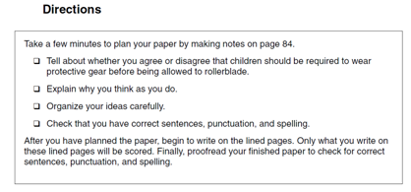
Example 1: ISAT 6th Grade Writing Prompt
Reliable?
Valid?
Authentic?
Interactive?
Practical?
Positive Impact?
From ISAT Sample Writing Handbook 2008 Grades 5, 6, and 8
Notes:
Example 1: ISAT 6th grade writing Prompt from the ISAT Sample Writing Handbook 2008, Grades 5, 6, and 8 from the Illinois State Board of Education
Is the assessment reliable? “To what extent would the child get the same results if another teacher were to assess their work?” (McKay, 2006, p. 113)
Is the assessment valid? “To what extent are the interpretations that teachers and assessors make on the basis of an assessment meaningful and appropriate?” (McKay, 2006, p. 113).
Is the assessment authentic? “To what extent does the assessment task reflect the kind of language children use in the classroom, or need in situations outside the classroom?” (McKay, 2006, p. 113).
Is the assessment interactive? “To what extent is the child’s language ability involved in accomplishing the task?” (McKay, 2006, p. 113).
Is the assessment Practical? “Are there sufficient resources for the task to work in the assessment situation, and with young learners?” (McKay, 2006, p. 113).
Does the assessment have a positive impact? “To what extent is the impact of the assessment positive on learns, teachers, parents, and society?” (McKay, 2006, p. 113)

Slide 33
Example 2: Identity Texts- Bernhard, Cummins, Campy, Ada, Winsler, Bleker 2006)
Children were exposed to bilingual literacy development through writing and illustrating their own dual language books, or IDENTITY TEXTS, in which they themselves appeared as the protagonists
Books were based on family histories, the children’s lives, and the children’s interests
Parents, family members, and educators wrote books as well
Children were encouraged to use their home languages and English in
describing the photographs.
Notes:
Example 2: Identity Texts Assignment from “Identity Texts and Literacy Development Among Preschool English Language Learners: Enhancing Learning Opportunities for Children at Risk for Learning Disabilities” by Bernhard, Cummins, Campy, Ada, Winsler, Bleker 2006.
Is the assessment reliable? “To what extent would the child get the same results if another teacher were to assess their work?” (McKay, 2006, p. 113)
Is the assessment valid? “To what extent are the interpretations that teachers and assessors make on the basis of an assessment meaningful and appropriate?” (McKay, 2006, p. 113).
Is the assessment authentic? “To what extent does the assessment task reflect the kind of language children use in the classroom, or need in situations outside the classroom?” (McKay, 2006, p. 113).
Is the assessment interactive? “To what extent is the child’s language ability involved in accomplishing the task?” (McKay, 2006, p. 113).
Is the assessment Practical? “Are there sufficient resources for the task to work in the assessment situation, and with young learners?” (McKay, 2006, p. 113).
Does the assessment have a positive impact? “To what extent is the impact of the assessment positive on learns, teachers, parents, and society?” (McKay, 2006, p. 113)

Slide 34
Common Assessment Issues
Not culturally relevant
Uses complex language
Contains bias
Not valid or reliable demonstration of knowledge
Requires high level of English Language Proficiency for reading, writing, listening, and/or speaking
Not “useful”
Notes:
As previously described, many standardized assessments and tradition classroom assessments do no adequately present opportunities for emergent bilingual students to demonstrate their knowledge. Common issues on both large scale assessments and classroom assessments are described on this slide. This is mostly a review of the factors previously discussed that need to be considered when creating assessments.
As discussed by the skunk example, many tests include questions or require the students to have background knowledge that is not culturally relevant.
Many large scale assessments use overcomplicated language that could easily be modified to be more accessible to emergent bilingual students and be just as comprehensible to native English speaking students. For example, a question from the linguistically modified 3rd grade ISAT test reads, “Which lines appear to be parallel?” The use of the phrase appears to be could definitely cause linguistic inaccessibility to students that are being assessed on their math skills. This phrase can just as easily be changed to “Which likes look like they are parallel?” This would cause much less confusion and would make the content of the question more accessible to emergent bilingual students.

Slide 35
What can YOU do?

Slide 36
Pre-Instructional Assessments/Build on Prior Knowledge
Give students a pre-instructional assessment
Engage students in lessons by having the draw on their background knowledge
Have students play a role in designing lessons
Brainstorming
Drawing from background knowledge
Notes:
Pre-instructional assessments are used to understand what students already know regarding the topic so that teachers can make informed instructional decisions.
A great way for students to build connections to the content learned in class is through relating the content to their own prior knowledge. Teachers can use introductory activities to engage the students and get an idea of what they already know about the content. For example, if a teacher is beginning a lesson on habitats, she might as the students “Where do you live? Where do birds live? Where do monkey’s live? Where do penguins live? Where do some of your favorite animals live? Tell me about the place where they live.” This will have students start thinking about what they know about habitats without even introducing the word habitat yet. The teacher now has culturally relevant examples to use because the students were able to describe where some of their favorite animals lived. She also got them thinking about what they know about habitats so they can start making connections better.
Another great way to make instruction and assessment more useful is to have the students play a role in designing lessons. For example, if a teacher is planning to begin a unit on insects, she could plan a brainstorming activity about insects. During this activity, students can describe insects they are familiar with from their home cultures and previous background knowledge. From this activity, the teacher then can plan what insects the class will focus on during their unit, instead of her choosing only insects that she is familiar with. This way, students see insects that they have chosen and they are familiar with from their prior knowledge, so students will be able to make connections and be assessed more fairly because the content of the instruction is culturally relevant and draws upon prior knowledge.

Slide 37
Allow L1 Use When Possible
L1 literacy promotes L2 literacy
Allows more accurate representation of knowledge
Provides safe
environment
Places value on
students home culture
and language

Slide 38
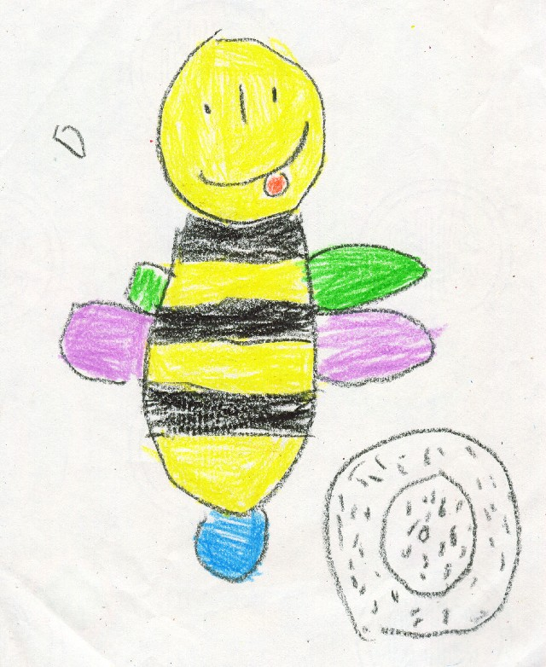
Multiple Domains For Demonstrating Knowledge
Drawings
Skits
Songs
Writing/speaking/
reading in L1
Creating stories
Show and tell
Other examples?
Notes:
Another thing you can do is create multiple domains for how you allow your students to demonstrate knowledge. Be creative and think of ways that students could best let you know what they know. Here is a list of some ways in which to do so. What are some other examples of create and useful ways for students to demonstrate their knowledge?

Slide 39
Be an Advocate
Advocate for use of L1 in schools
Advocate for useful assessments in the school and in classroom
Spread awareness of unique considerations for emergent bilingual students
Advocate for high value placed on cultural and linguistic identities of students

Slide 40
Be Aware
Continually be aware of the students cultural and linguistic identities in your class, and how those affect learning
Be aware of your own attitudes, beliefs, an identity and how those shape your instruction and assessment
Be aware of the value of diversity in the classroom and how that creates a positive and enriched learning enviornment

Slide 41
Conclusion
Every student that enters your class is an unique and talented individual that comes to class with a set of special and valuable skills and identity- use these individual qualities to shape life long love for learning in your classroom!

